Slide 1




Peking University
Benchmark & Augment LLMs for Chemistry
An Integrated Approach via the ChemCOTBench Benchmark and the ChemCRAFT Framework
Presenter
Hao Li
2026.1.25
Notes:
Good morning everyone. My name is Hao Li from Peking University. It’s my honor to give the presentation on this AI for research workshop. My topic is Benchmarking and augmenting LLMs for chemistry.

Slide 2
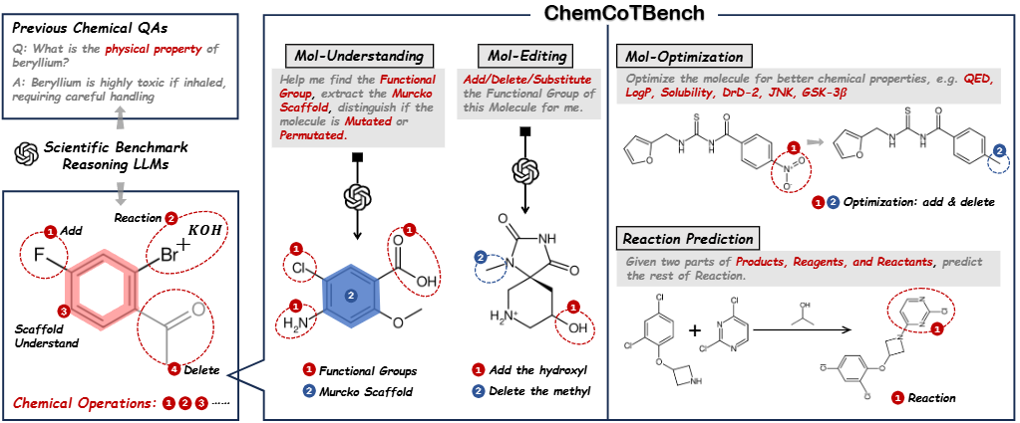

Beyond Chemical QA: Chemical Reasoning with Modular Chemical Operations
Motivation: Building Chemical Reasoning Benchmark for LLMs
While reasoning LLMs (O3, R1, K2) excel in complex reasoning and general STEM tasks, the domain of Chemistry remains a notable challenge and has yet to be effectively integrated.
Current chemical Eval benchmarks are knowledge retrieval rather than reasoning
Functional Group
Operations:
The “Language” of
Molecular Reasoning
2
Notes:
at the beginning of the speech, I would like to clarify our motivation, which is to build the chemical reasoning benchmark for LLMs.
There are several Chemical QA benchmark that focus on factual knowledge retrieval, but none of them are suitable for evaluating the step-by-step reasoning ability for chemical tasks. Thus, we select four key tasks in chemical domain, including molecule understanding, editing, optimization and reaction prediction tasks. For each tasks, we gather the chain-of-thoughts data and evaluate the reasoning LLMs from the step-wise reasoning aspect.
(1). Chem领域难以纳入的原因：ChemQA数据集为factual knowledge retrieval 更依赖领域先验知识(而非step-by-step Reasoning)
(2). 解决方案：在化学领域选择四类任务 分子理解, 分子结构改进 (基础任务) 分子优化, 化学方程式预测(多分子结构), 并分为22个subtasks, 针对每个任务建立合理的思维链过程, 从step-wise reasoning的角度评测现有Reasoning-LLM的能力

Slide 3
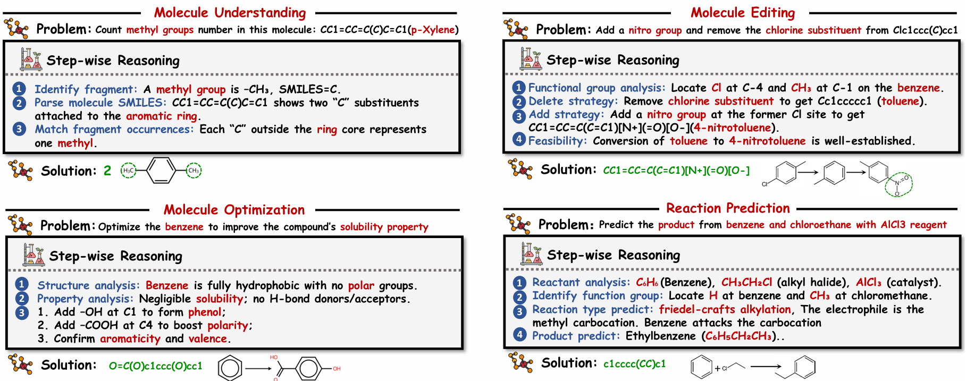
Beyond Chemical QA: Chemical Reasoning with Modular Chemical Operations
Building Chain-of-Thought Trajectory for Molecular Tasks
3
Notes:
Here is the detail of how we build the chain-of-thought trajectory for molecule tasks. Take the molecule editing as an example, chemical experts first decouple the thinking process of complex chemical tasks into highly modular chemical operation templates, and then we use LLMs to complete the templates as the chain-of-thought trajectory .
将复杂化学推理任务的中间过程解耦成高度模块化的 Meta-Operations

Slide 4
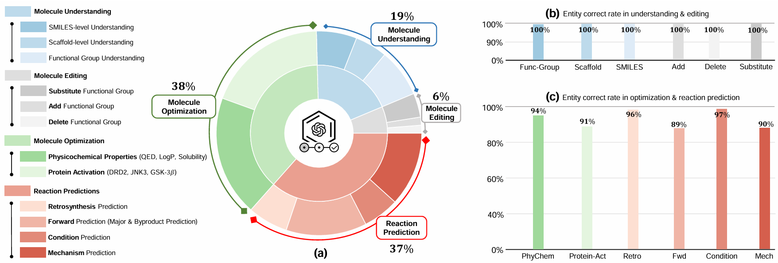
Beyond Chemical QA: Chemical Reasoning with Modular Chemical Operations
ChemCoTBench & ChemCoTDataset: For training and evaluation
Human Evaluation: Expert scoring for both final answers and key reasoning steps (functional groups, reaction types, molecules).
Data-Scale: 1.5K expert-annotated samples (ChemCoTBench) & 25K SFT/RL data points (ChemCoTDataset).
4
Notes:
With the pipeline mentioned previously, we build up two datasets, a high-quality chemcotbench for evaluation, and a ChemCoTDataset for further training.
We also complete comprehensive human evaluations on chemcotbench to guarantee its quality. As for the data-scale, our chemcotbench contains 1.5 thousand expert-annotated samples, and our chemcotdataset contains 25 thousand samples for further LLM training with sft or reinforcement learning procedure.

Slide 5
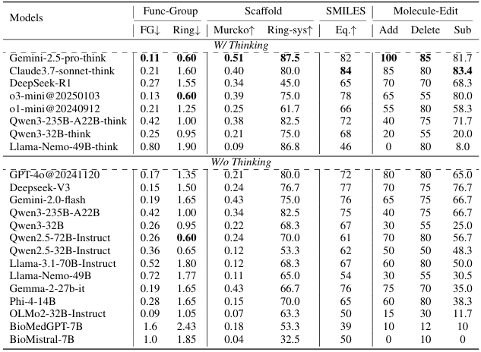
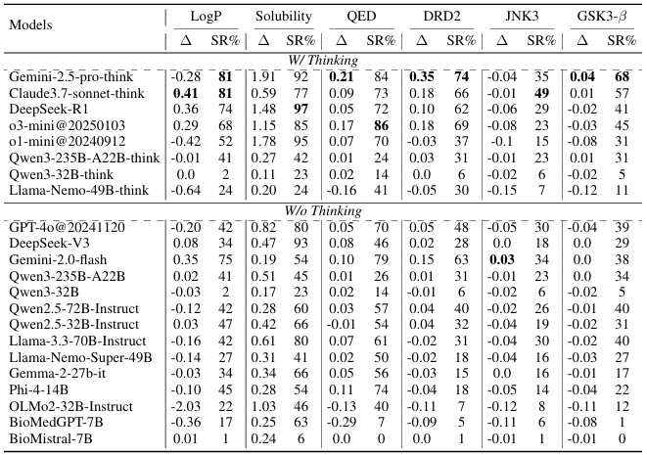
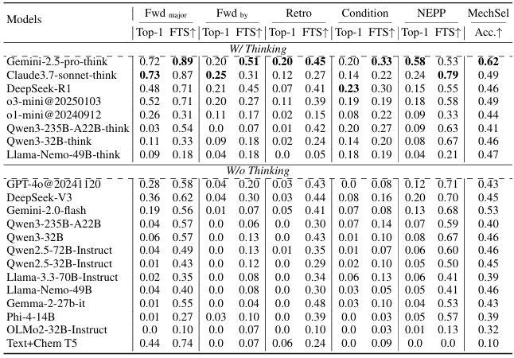
Beyond Chemical QA: Chemical Reasoning with Modular Chemical Operations
Experimental Results & Takeaways
(1). Closed-Source > Open-Source in Chemistry: Superior overall performance correlates with richer chemical knowledge
(2). No Chemical Reasoning Boost from "Thinking" Tuning: Open-source reasoning models (e.g., Qwen-3, Llama-Nemotron) show no clear gain in chemistry, indicating their CoT capabilities are domain-specific (math/code) and not universally transferable.
Mol-Understanding & Editing
Mol-Optimization
Reaction Prediction
5
Notes:
By evaluating current LLMs on our chemcotbench, we can provide two takeaways opinions. First is that Closed-Source LLMs are better than Open-Source LLMs in Chemistry Domain: Superior overall performance correlates with richer chemical knowledge
Second is that No Chemical Reasoning Boost from "Thinking" mode of LLM: Open-source reasoning models show no clear gain in chemistry under their thinking mode, indicating their CoT capabilities are domain-specific ( which only covers math/code ) and not universally transferable

Slide 6
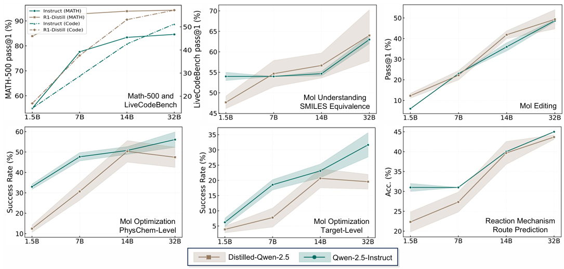
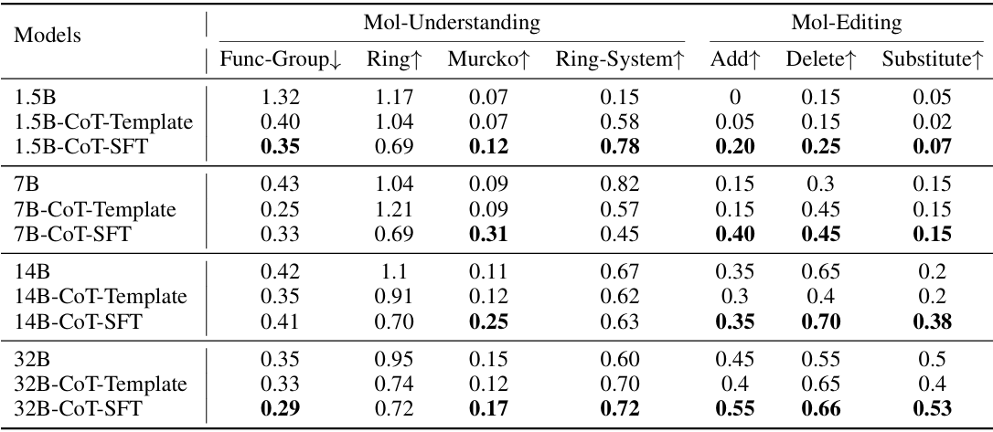
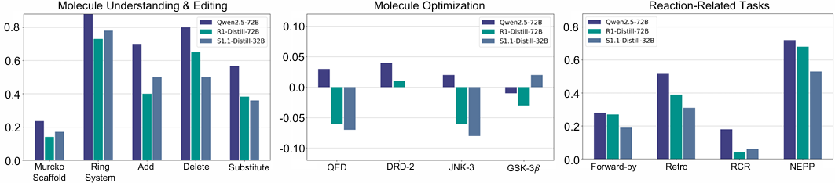
Beyond Chemical QA: Chemical Reasoning with Modular Chemical Operations
How to improve Chemical Reasoning: Distillation or SFT
(1). Distillation Strategy: Following DeepSeek-R1, distilling Chain-of-Thought data effectively boosts reasoning in small models (1.5B-72B), e.g., S1.1, Yixin-Distill, S1-Distill
(2). Limited Transferability of Distilled Reasoning: Distillation models have much better performance on math/code than chemistry, suggesting overfitting to source tasks and a lack of cross-domain transferability in distilled reasoning skills.
ChemCoTDatset-SFT: Successfully Improve
- CoT-Template: Prompt-Tuning by giving chemical reasoning template
- CoT-SFT: Full parameter tuning on ChemCotDataset, Epoch=2
6
Notes:
And the next vital question is, How to improve Chemical Reasoning. Here we try both the distillation strategy and SFT strategy. The distillation strategy is to distill Chain-of-thoughts from expert models and boost reasoning on small models,. Including Yixin-Distill and S1-Distill. However, we find that Distillation models have much better performance on math/code than chemistry, suggesting overfitting to source tasks and a lack of cross-domain transferability in distilled reasoning skills. So a second way to improve the chemical reasoning is to SFT on chemcotdataset. Compared to distillation strategy and prompt tuning strategy, the SFT can successfully improve the chemical reasoning ability. Which also demonstrating the effectiveness of our proposed dataset.

Slide 7
Beyond Chemical QA: Chemical Reasoning with Modular Chemical Operations
Question: Is there a better way to improve Chemical Reasoning?
We have explored multiple approaches to this problem and identified a viable path forward through agentic reinforcement learning.
7
Notes:
But the SFT training is still to naïve. Our next question is, is there a better way to improve chemical reasoning? We have explored multiple approaches to this problem and identify a viable path through agentic reinforcement learning.

Slide 8
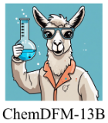
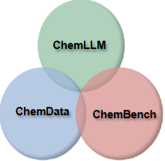

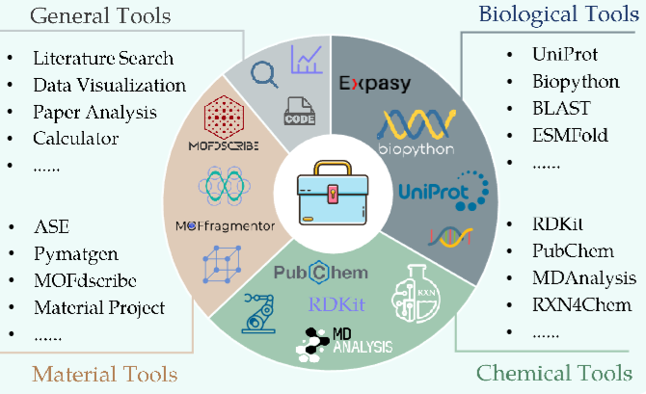
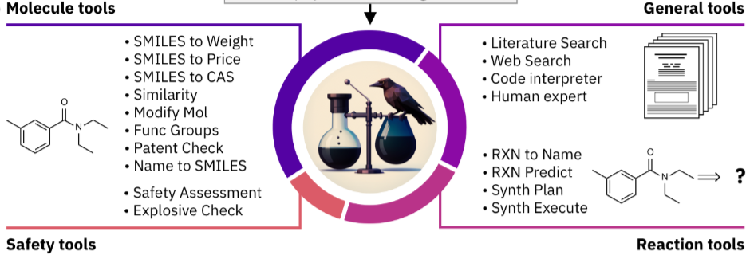
ChemCraft: A next-generation Chemical Language Model via Agentic-RL
Chemical Language Models: AI-Assistant for Chemistry Experts
(1). Made advances in assisting chemists with tasks
(2). Further breakthroughs in real-world applications, including device control in laboratory settings & scientific idea discovery
CLMs with SFT
Next-Generation: Agentic-RL
Costly for long content
Money & Carbon Output
Human-Like: Human scientists integrate fundamental chemical principles with reasoning capabilities, utilizing tools such as literature review, computational simulation, and database mining to achieve domain discovery.
Chem-R-8B
Workflow-Flexibility
ChemCraft: Similar to the discovery process of human scientists, use small language model(7B-32B) to provide basic reasoning and agent calling ability. Interaction with Chemical Agents for science Knowledge.
CLMs with Multi-Agent-System
Data-privacy
LLM-Api-Stability
Sci-Agent
ChemCrow
Reasoning ONLY in [Semantic Space]→ [Semantic Space] + [Agent Space]
Notes:
And this lead to our second work, ChemCraft, which is currently released on Arxiv. Our chemcraft is an agentic-RL based chemical language model. And is similar to the discovery process of human scientists, use small language model(7B-32B) to provide basic reasoning and agent calling ability. Interaction with Chemical Agents for science Knowledge. The main difference between our ChemCraft and previous chemical language model is that, previous language models reasoning only in semantic space, while our model reasoning on both semantic space and chemical agent space, allowing our model to be better performed and less hallucination.

Slide 9
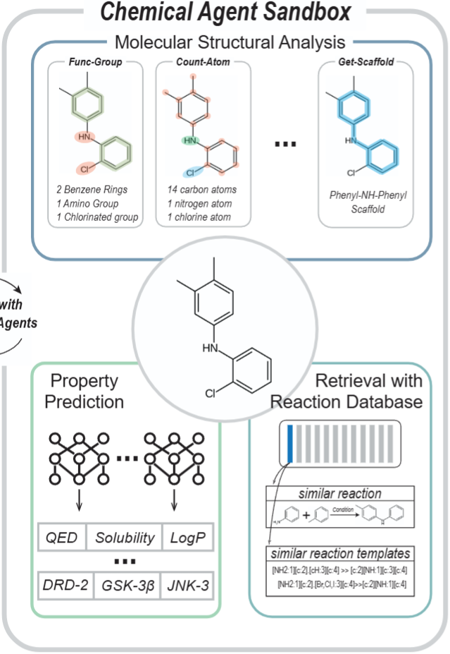
ChemCraft: A next-generation Chemical Language Model via Agentic-RL
ChemCraft Construction: Chemical Agent Sandbox
Functions
Deep-Learning
SmilesWeight
MolSimilarity
AtomCount
FuncGroupIdentity
FuncGroupEdit
ScaffoldPrediction
AddFunctionalGroup
RemoveFunctionGroup
ReplaceFunctionGroup
JNK3PropPredictor
GSK3PropPredictor
DRD2PropPredictor
LogpPropPredictor
QEDPropPredictor
SolubilityPropPredictor
Structural-RAG
RXN, PubChem DB
(1). Faiss.IndexFlatIP to create id for retrieval, we further use PCA for acceleration
(2). FastAPI + uvicorn.run, for establishing web server
Notes:
The first part of chemcraft is the construction of chemical agent sandbox. The agents can be splited into three parts: agents based on calculation functions, agents based on deep-learning, and agents based on structural RAG. All these 19 types of chemical agents can cover most of the organic chemistry tasks.

Slide 10
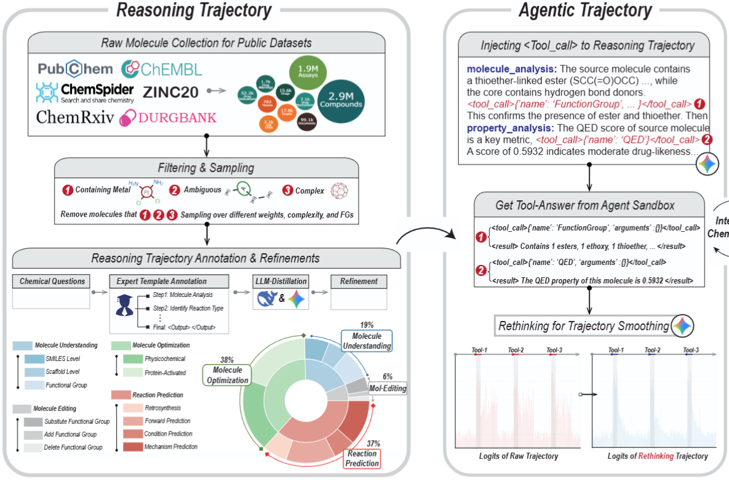
ChemCraft: A next-generation Chemical Language Model via Agentic-RL
ChemCraft Construction: Agentic-Reasoning Trajectory
Agentic Trajectory: Based on the reasoning trajectory, agent positions are determined by LLMs. The trajectory is then smoothed after tool results are incorporated to mitigate token oscillation induced by agent interventions.
Two-Stage Training: Apply 30% of the reasoning trajectory for Cold-Start SFT and the other 70% of the reasoning trajectory for Agentic-RL. We apply GRPO as our RL algorithm with well-designed chemical rewards.
Notes:
The Second part of chemcraft is agentic trajectory building and training. Based on the reasoning trajectory, the agent-calling positions are determined by LLMs. after <tool_results> are incorporated. The trajectory is smoothed by rethinking process, which can significantly lower the token logits. As for the training, we use two-stage training with cold-start SFT and agentic reinforcement learning

Slide 11
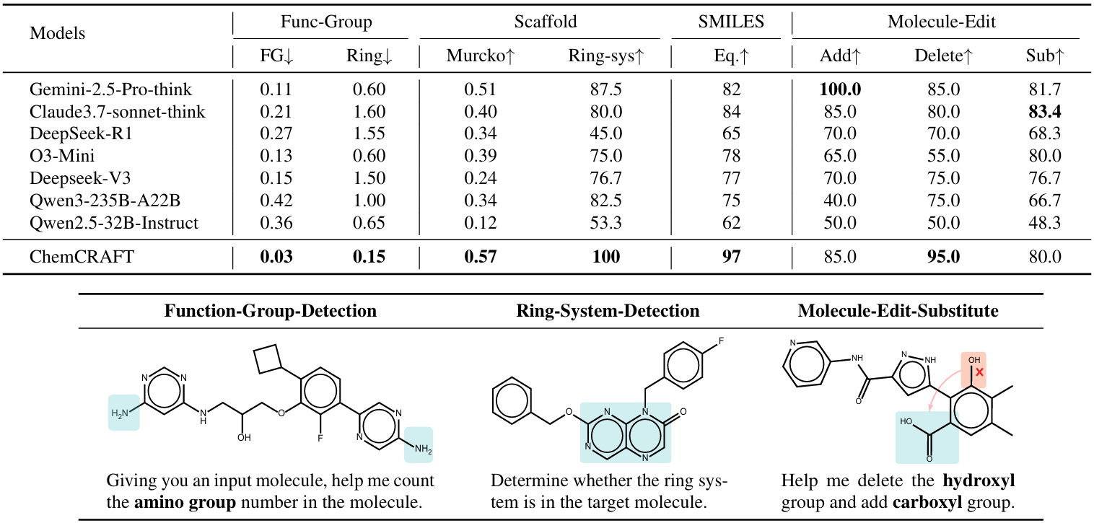
ChemCraft: A next-generation Chemical Language Model via Agentic-RL
Experimental Analysis on Molecule Structure Analysis & Editing
(1) When fine-tuned for 1 epochs on the ChemCoTDataset after extending its tool interaction capabilities, the Qwen2.5-7B/14B base model stably outperforms DeepSeek-Thinking (RAG version) and even surpasses top-tier general-purpose LLMs such as Gemini-2.5 and Claude-3 across multiple tasks.
Notes:
As for the experiments, our ChemCraft stably outperforms DeepSeek-Thinking version and even surpasses top-tier general-purpose LLMs such as Gemini-2.5 and Claude-3 across multiple tasks.

Slide 12
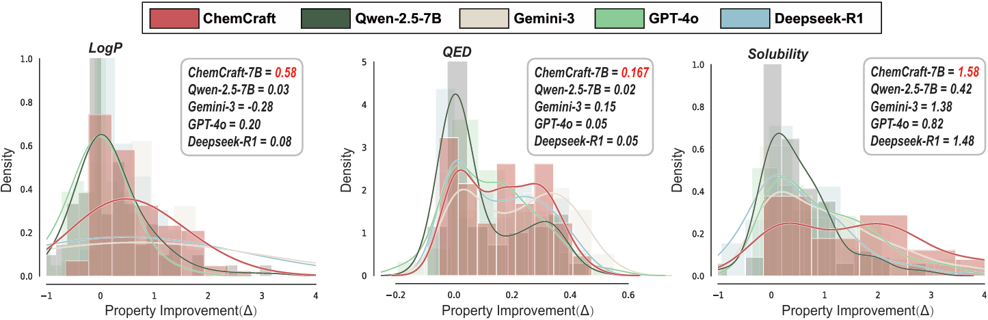
ChemCraft: A next-generation Chemical Language Model via Agentic-RL
Experimental Analysis on Molecule Optimization
(1) Faced with more complex chemical tasks, including molecular optimization and reaction prediction tasks. By leveraging molecular property prediction tools, our model also effectively optimizes multiple properties, including logP, solubility, QED, DRD2, JNK3, and GSK3.
Notes:
For LogP, QED, and Solubility properties in molecular optimization tasks, we visualize the improvement distribution and discover that the peak of chemcraft has significant right move compared to the original Qwen-7B backbone. The quantitive score also show the significant improvement after the agentic interaction.

Slide 13
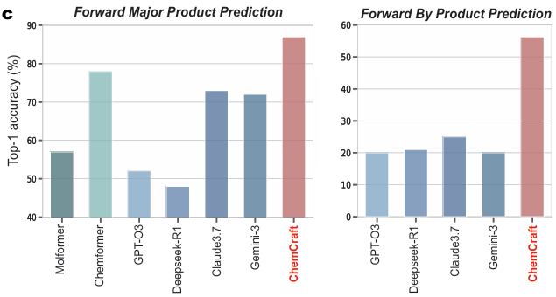
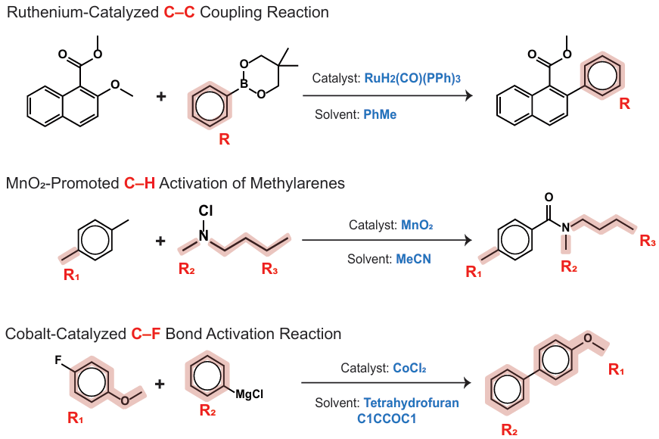
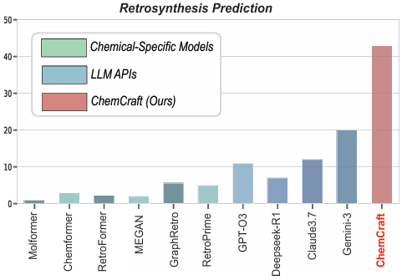
ChemCraft: A next-generation Chemical Language Model via Agentic-RL
Experimental Analysis on Reaction Prediction Tasks
(1) Validation on Reaction Prediction: ChemCraft demonstrates strong performance in both forward and retrosynthesis. Notably, it succeeds even on non-polar coupling reactions, which is a chemist-focused class beyond standard USPTO data.
Notes:
Here is the experimental analysis on reaction prediction tasks. Our ChemCraft can do well on both forward prediction and retrosynthesis prediction tasks. We make visualizations and find that ChemCraft succeeds even on non-polar coupling reactions, which is a complex reaction type that chemist focused beyond standard USPTO data

Slide 14
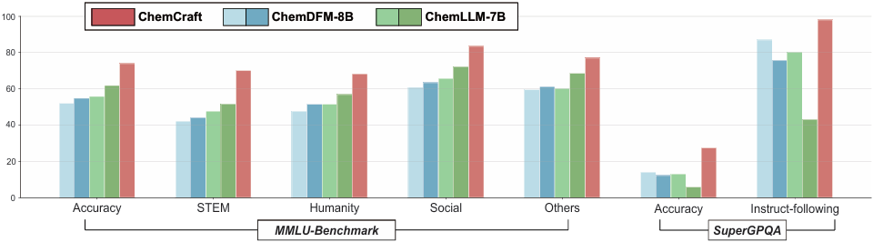
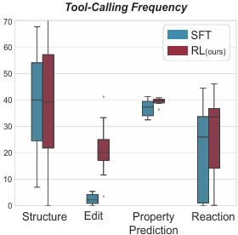
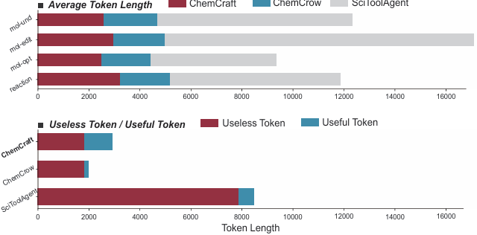
ChemCraft: A next-generation Chemical Language Model via Agentic-RL
Experimental with other Chemical Language Models
(1) Well General Reasoning Ability: Despite ChemCraft’s chemical excellence, we verified that ChemCraft suffers no catastrophic forgetting. Evaluations against baselines (ChemLLM, ChemDFM) show preserved general knowledge and instruction-following, demonstrating domain specialization without compromise.
(2) Low Cost: We further benchmarked ChemCRAFT against multi-agent systems to demonstrate its efficiency. ChemCRAFT achieves superior performance with a lower average token count than baselines like ChemCrow and SciToolAgent. A key factor is that these agent frameworks consume substantial tokens on context management and rigid prompt formatting, leaving limited budget for actual reasoning tokens.
Notes:
ChemCraft performs excellent on chemical tasks. Our first thought is: does it suffer from catastrophic forgetting? does it lost general reasoning and instruction-following abilities? By comparing it with baselines like ChemLLM and ChemDFM, we find that ChemCraft actually retains its general knowledge very well and maintains strong instruction-following ability.
We also compared ChemCraft with multi-agent system baselines to demonstrate its low reasoning cost. We found that ChemCraft uses fewer tokens on average than ChemCrow and SciToolAgent. One reason why ChemCraft performs better is that ChemCrow and SciToolAgent spend a lot of tokens on context switching and fixed-format prompts, leaving relatively few tokens for actual thinking.

Slide 15
Conclusion
ChemCoTBench, ChemCoTDataset & ChemCraft
Collectively, our work delivers a benchmark (ChemCoTBench), a training corpus (ChemCoTDataset), and an agent (ChemCRAFT) for chemical reasoning. This framework, combined with the Agentic-RL pathway, provides an effective blueprint for applying LLMs to scientific discovery
Future Work for ChemCraft, from molecule to Protein and Single Cell
Towards Protein Structure Prediction
Towards Genomic Reasoning
Target: Extend the reasoning paradigm from small molecules to complex Protein Structures.
Approach: Incorporate 3D geometric priors and folding kinetics into the Interleaved-Thinking framework. Enable the agent to reason about Protein-Ligand interactions and enzyme catalysis pathways using specialized simulation tools.
Goal: Developing a Thinking Agent for De novo protein design and functional prediction.
Target: Transitioning from discrete chemical reactions to High-resolution Genetics, including DNA and RNA.
Goal: Enabling the model to propose hypotheses for Gene Regulation and cellular response to chemical perturbations at a single-cell level.
Notes:
Finally, the conclusion part. In this presentation, we propose ChemCoTBench, ChemCoTDataset & ChemCraft, containing the evaluation and improvement on LLM chemical reasoning task. Future works for chemcraft will transfer the molecule domain to protein and single cell domains. And we hope our work can accelerate the community of scientific foundation model.

Slide 16


ChemCoTBench, ChemCoTDataset & ChemCraft
Thanks For Your Listening
Any Question?
ChemCoTBench & ChemCoTDataset
ChemCraft
16

